Slide 1
Probability Basics
CS771: Introduction to Machine Learning
Nisheeth

Slide 2
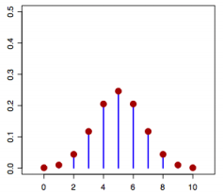
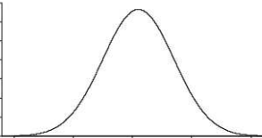

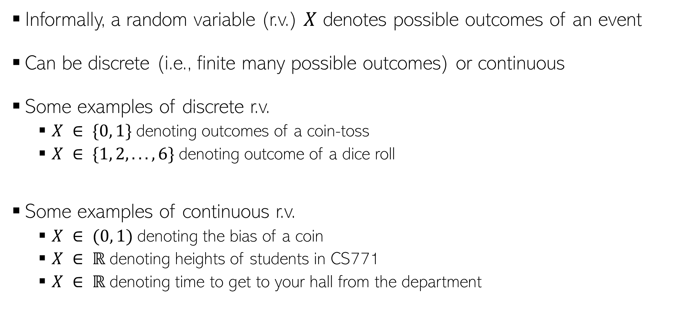



Random Variables
Informally, a random variable (r.v.) $X$ denotes possible outcomes of an event
Can be discrete (i.e., finite many possible outcomes) or continuous
Some examples of discrete r.v.
$X ∈ \{0, 1\}$denoting outcomes of a coin-toss
$X ∈ \{1, 2, . . . , 6\}$denoting outcome of a dice roll
Some examples of continuous r.v.
$X ∈ (0, 1)$denoting the bias of a coin
$X ∈ ℝ$denoting heights of students in CS771
$X ∈ ℝ$denoting time to get to your hall from the department
$$p(X)$$
$X$(a discrete r.v.)
$$p(X)$$
$X$(a continuous r.v.)

Slide 3
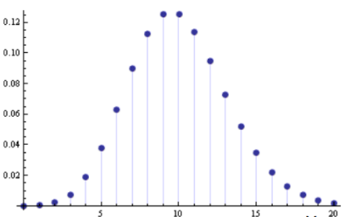




Discrete Random Variables
For a discrete r.v. $X$, $p(x)$ denotes $p(X = x)$ - probability that $X = x$
$p(X)$ is called the probability mass function (PMF) of r.v. $X$
$p(x)$ or $p(X = x)$ is the value of the PMF at $x$
$$p\left(x\right)≥0$$
$$p\left(x\right)≤ 1$$
$$\sum_{x}{p\left(x\right)=1}$$
$$p(X)$$
$$X$$

Slide 4
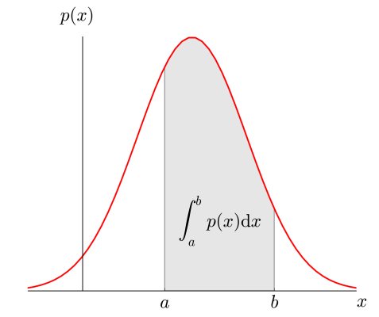


Continuous Random Variables
For a continuous r.v. $X$, a probability $p(X = x)$ or $p(x)$ is meaningless
For cont. r.v., we talk in terms of prob. within an interval $X ∈(x,x+δx)$
$p(x)δx$ is the prob. that $X ∈(x,x+δx)$as $δx→0$
$p(x)$ is the probability density at $X= x$
$$p\left(x\right)≥0$$
$$p\left(x\right)≤ 1$$
$$\int{p\left(x\right)dx=1}$$

Slide 5
Discrete example: roll of a die
p(x)
1/6
x
1
2
3
4
5
6

Slide 6
Probability mass function (pmf)
x
p(x)
1
p(x=1)=1/6
2
p(x=2)=1/6
3
p(x=3)=1/6
4
p(x=4)=1/6
5
p(x=5)=1/6
6
p(x=6)=1/6

Slide 7
Cumulative distribution function
x
P(x≤A)
1
P(x≤1)=1/6
2
P(x≤2)=2/6
3
P(x≤3)=3/6
4
P(x≤4)=4/6
5
P(x≤5)=5/6
6
P(x≤6)=6/6

Slide 8
Cumulative distribution function (CDF)
1.0
P(x)
5/6
2/3
1/2
1/3
1/6
1
2
3
4
5
6
x

Slide 9
Practice Problem
The number of patients seen in a clinic in any given hour is a random variable represented by x. The probability distribution for x is:
x
10
11
12
13
14
P(x)
.4
.2
.2
.1
.1
Find the probability that in a given hour:
a. exactly 14 patients arrive
b. At least 12 patients arrive
c. At most 11 patients arrive
p(x=14)= .1
p(x≥12)= (.2 + .1 +.1) = .4
p(x≤11)= (.4 +.2) = .6

Slide 10
Continuous case
The probability function that accompanies a continuous random variable is a continuous mathematical function that integrates to 1.
For example, recall the negative exponential function (in probability, this is called an “exponential distribution”):
This function integrates to 1:

Slide 11
Continuous case: “probability density function” (pdf)
p(x)=e^{-x}
1
x
The probability that x is any exact particular value (such as 1.9976) is 0; we can only assign probabilities to possible ranges of x.

Slide 12
For example, the probability of x falling within 1 to 2:
p(x)=e^{-x}
1
x
1
2

Slide 13
Example 2: Uniform distribution
The uniform distribution: all values are equally likely.
f(x)= 1 , for 1≥ x ≥0
p(x)
1
x
1
We can see it’s a probability distribution because it integrates to 1 (the area under the curve is 1):

Slide 14
Example: Uniform distribution
What’s the probability that x is between 0 and ½?
p(x)
1
0
½
x
1
P(½ ≥x≥ 0)= ½

Slide 15
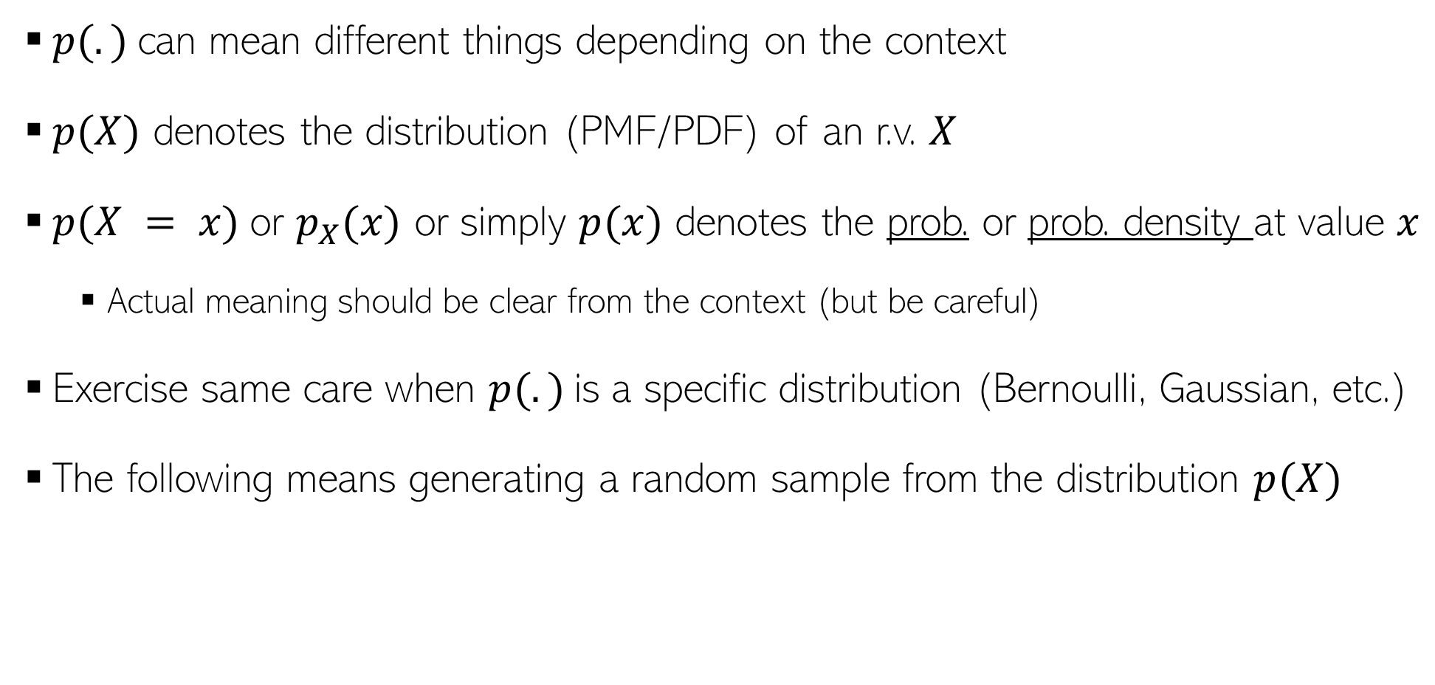
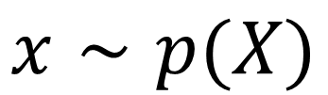
A word about notation
$p(.)$can mean different things depending on the context
$p(X)$ denotes the distribution (PMF/PDF) of an r.v. $X$
$p(X = x)$or $p_{X}(x)$ or simply $p(x)$ denotes the prob. or prob. density at value $x$
Actual meaning should be clear from the context (but be careful)
Exercise same care when $p(.)$is a specific distribution (Bernoulli, Gaussian, etc.)
The following means generating a random sample from the distribution $p(X)$
$$x∼p(X)$$

Slide 16

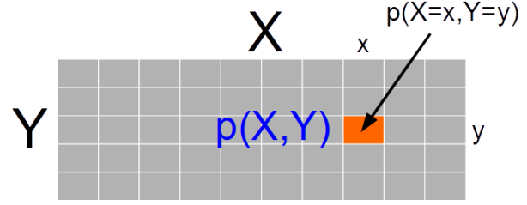
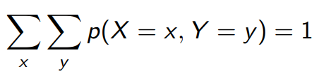
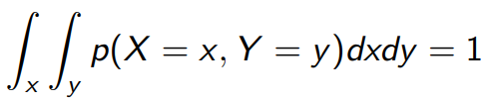

Joint Probability Distribution
Joint prob. dist. $p(X, Y)$ models probability of co-occurrence of two r.v. $X, Y$
For discrete r.v., the joint PMF $p(X, Y )$is like a table (that sums to 1)
For two continuous r.v.’s $X$ and $Y$, we have joint PDF $p(X, Y)$
For 3 r.v.’s, we will likewise have a “cube” for the PMF. For more than 3 r.v.’s too, similar analogy holds
For more than two r.v.’s, we will likewise have a multi-dim integral for this property

Slide 17
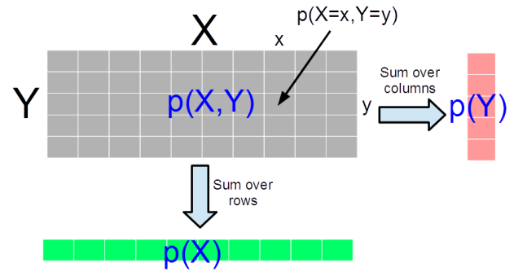

Marginal Probability Distribution
Consider two r.v.’s X and Y (discrete/continuous – both need not of same type)
Marg. Prob. is PMF/PDF of one r.v. accounting for all possibilities of the other r.v.
For discrete r.v.’s, $p\left(X\right)= \sum_{y}{p(X,Y=y)}$ and $p\left(Y\right)=\sum_{x}{p(X=x,Y)}$
For discrete r.v. it is the sum of the PMF table along the rows/columns
For continuous r.v.’s,
The definition also applied for two sets of r.v.’s and marginal of one set of r.v.’s is obtained by summing over all possibilities of the second set of r.v.’s
For discrete r.v.’s, marginalization is called summing over, for continuous r.v.’s, it is called “integrating out”

Slide 18
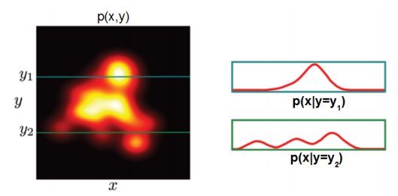
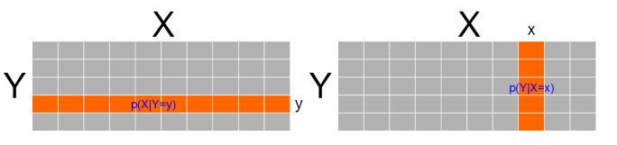
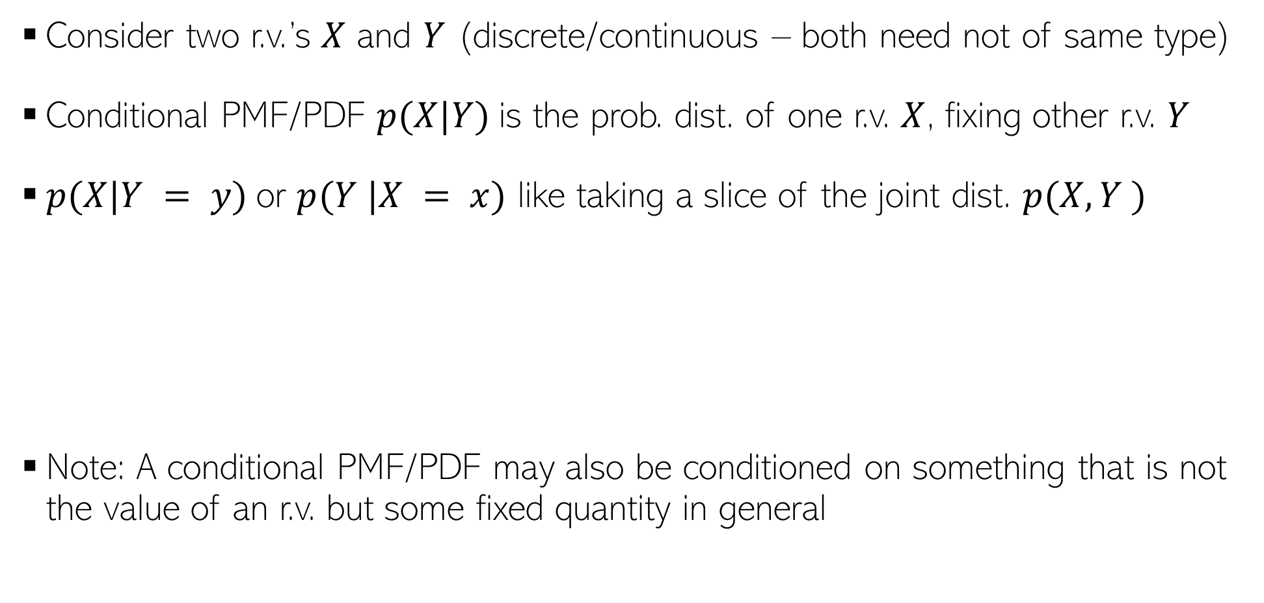
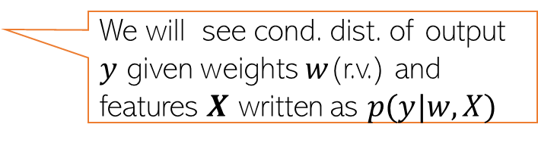
Conditional Probability Distribution
Consider two r.v.’s $X$ and $Y$ (discrete/continuous – both need not of same type)
Conditional PMF/PDF $p(X|Y)$is the prob. dist. of one r.v. $X$, fixing other r.v. $Y$
$p(X|Y = y)$or $p(Y |X = x)$ like taking a slice of the joint dist. $p(X, Y )$
Note: A conditional PMF/PDF may also be conditioned on something that is not the value of an r.v. but some fixed quantity in general
Continuous Random Variables
Discrete Random Variables
We will see cond. dist. of output $y$ given weights $w$(r.v.) and features $X$ written as $p(y|w,X)$

Slide 19
An example
X/Y | raining | sunny
Umbrella | 0.5 | 0.1
No umbrella | 0.2 | 0.2
P (B|A)p(A) = p(A|B)p(B)
P(x) = {0.6, 0.4}
P(y) = {0.7, 0.3}
A
P(A,B)
P(X|Y = raining) = {0.5, 0.2}
B
P(X = umbrella|Y = raining)

Slide 20
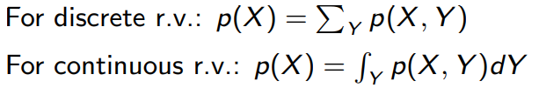
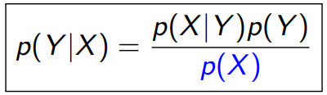
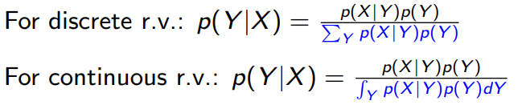
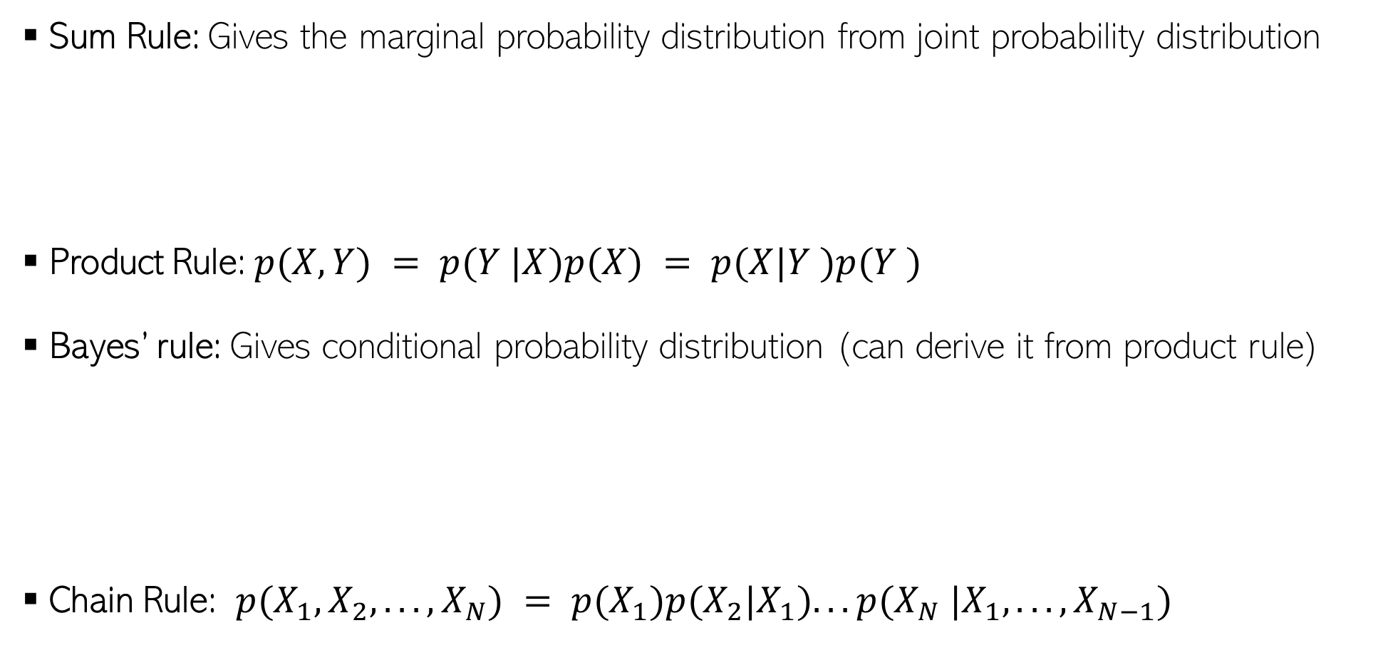
Some Basic Rules
Sum Rule: Gives the marginal probability distribution from joint probability distribution
Product Rule: $p(X, Y) = p(Y |X)p(X) = p(X|Y )p(Y )$
Bayes’ rule: Gives conditional probability distribution (can derive it from product rule)
Chain Rule: $p(X_{1}, X_{2}, . . . , X_{N}) = p(X_{1})p(X_{2}|X_{1}). . . p(X_{N} |X_{1}, . . . , X_{N−1})$

Slide 21

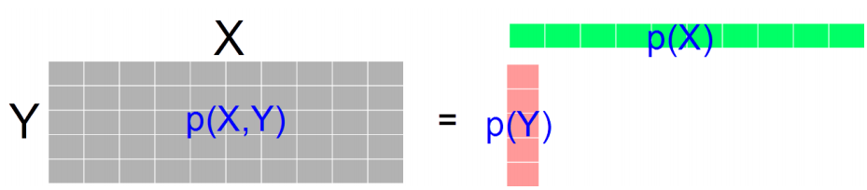


Independence
$X$ and $Y$ are independent when knowing one tells nothing about the other
The above is the marginal independence $(X ⫫ Y)$
Two r.v.’s $X$ and $Y$ may not be marginally indep but may be given the value of another r.v. $Z$

Slide 22

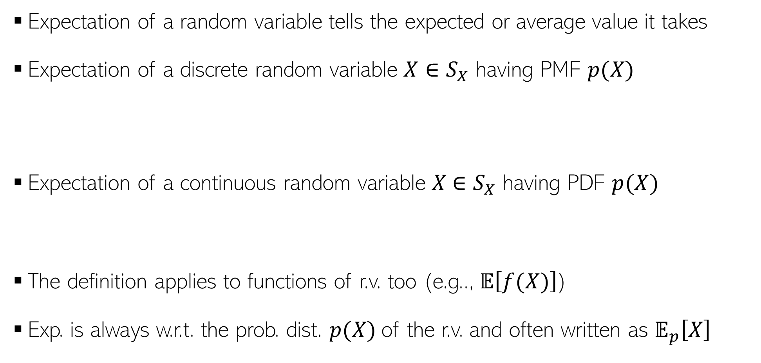

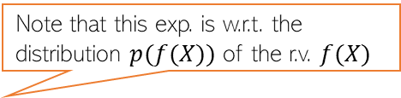
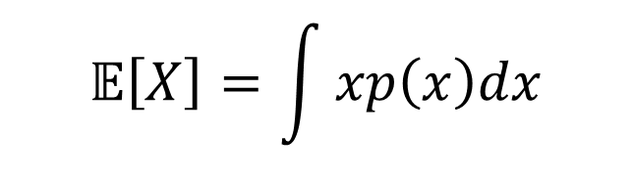
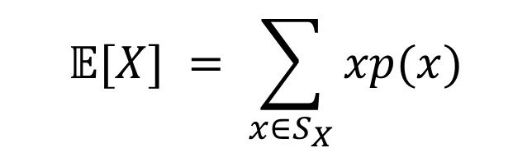

Expectation
Expectation of a random variable tells the expected or average value it takes
Expectation of a discrete random variable $X∈S_{X}$ having PMF $p(X)$
Expectation of a continuous random variable $X$ $∈S_{X}$ having PDF $p(X)$
The definition applies to functions of r.v. too (e.g.., $𝔼\left[f(X)\right]$)
Exp. is always w.r.t. the prob. dist. $p(X)$of the r.v. and often written as $𝔼_{p}\left[X\right]$
$$𝔼[X] = \sum_{x∈S_{X}}{xp(x)}$$
Probability that $X = x$
$$𝔼\left[X\right]=\int{xp\left(x\right)dx}$$
Probability density at $X = x$
Note that this exp. is w.r.t. the distribution $p(f(X))$ of the r.v. $f(X)$
$$x∈S_{X}$$
Often the subscript is omitted but do keep in mind the underlying distribution

Slide 23
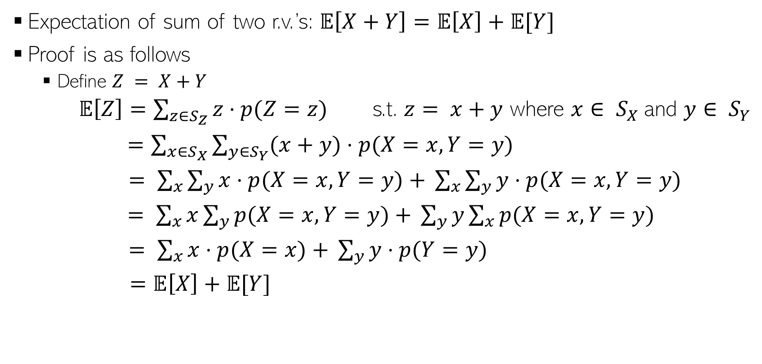
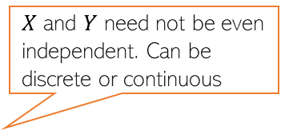
Expectation: A Few Rules
$X$ and $Y$ need not be even independent. Can be discrete or continuous
Expectation of sum of two r.v.’s: $𝔼\left[X+Y\right]=𝔼\left[X\right]+𝔼[Y]$
Proof is as follows
Define $Z = X+Y$
$𝔼\left[Z\right]=\sum_{z∈S_{Z}}{z⋅p(Z=z)}$ s.t. $z= x+y$ where $x∈ S_{X}$and $y∈ S_{Y}$
$=\sum_{x∈S_{X}}{\sum_{y∈S_{Y}}{(x+y)⋅p(X=x,Y=y)}}$
$= \sum_{x}{\sum_{y}{x⋅p(X=x,Y=y)}}$ $+ \sum_{x}{\sum_{y}{y⋅p(X=x,Y=y)}}$
$= \sum_{x}{x\sum_{y}{p(X=x,Y=y)}}$ $+ \sum_{y}{y\sum_{x}{p(X=x,Y=y)}}$
$= \sum_{x}{x⋅p(X=x)}$ $+ \sum_{y}{y⋅p(Y=y)}$
$=𝔼\left[X\right]+𝔼[Y]$
Used the rule of marginalization of joint dist. of two r.v.’s

Slide 24

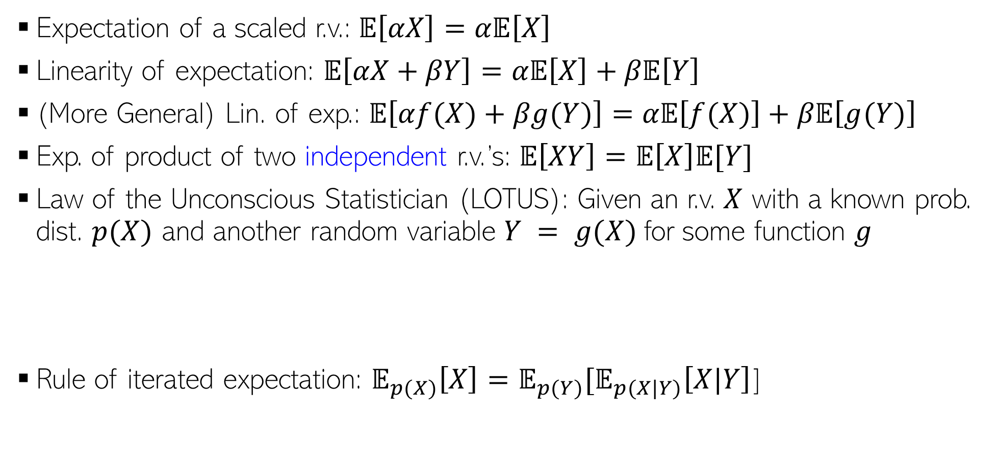

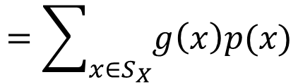
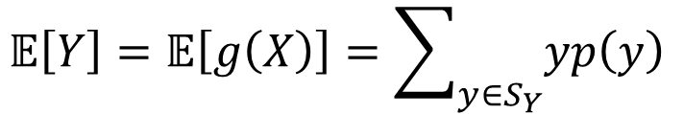



Expectation: A Few Rules (Contd)
$α$is a real-valued scalar
$α$and $β$are real-valued scalars
Expectation of a scaled r.v.: $𝔼\left[αX\right]=α𝔼\left[X\right]$
Linearity of expectation: $𝔼\left[αX+βY\right]=α𝔼\left[X\right]+β𝔼\left[Y\right]$
(More General) Lin. of exp.: $𝔼\left[αf(X)+βg(Y)\right]=α𝔼\left[f(X)\right]+β𝔼\left[g(Y)\right]$
Exp. of product of two independent r.v.’s: $𝔼\left[XY\right]=𝔼\left[X\right]𝔼[Y]$
Law of the Unconscious Statistician (LOTUS): Given an r.v. $X$ with a known prob. dist. $p(X)$ and another random variable $Y = g(X)$for some function $g$
Rule of iterated expectation: $𝔼_{p(X)}\left[X\right]=𝔼_{p(Y)}[𝔼_{p(X|Y)}\left[X|Y\right]$]
$f$ and $g$ are arbitrary functions.
Requires finding $p(Y)$
Requires only $p(X)$ which we already have
$$𝔼\left[Y\right]=𝔼\left[g\left(X\right)\right]=\sum_{y∈S_{Y}}{yp\left(y\right) }$$
$$=\sum_{x∈S_{X}}{g\left(x\right)p(x)}$$
LOTUS also applicable for continuous r.v.’s

Slide 25
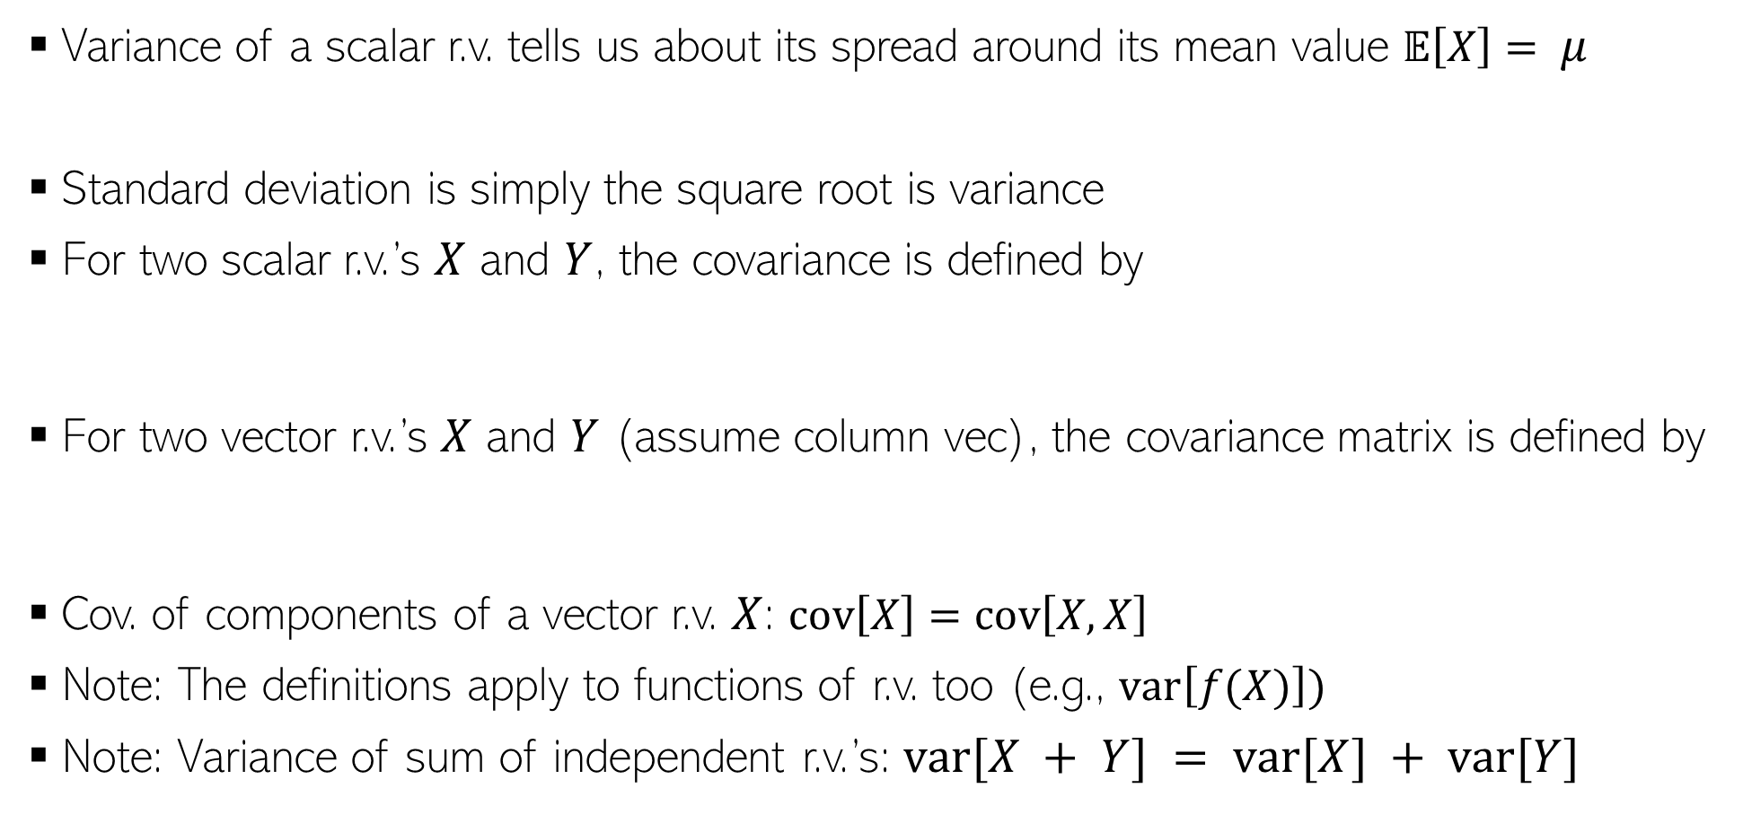
Variance and Covariance
Variance of a scalar r.v. tells us about its spread around its mean value $𝔼\left[X\right]= μ$
Standard deviation is simply the square root is variance
For two scalar r.v.’s $X$ and $Y$, the covariance is defined by
For two vector r.v.’s $X$ and $Y$ (assume column vec), the covariance matrix is defined by
Cov. of components of a vector r.v. $X$: $cov\left[X\right]=cov\left[X,X\right]$
Note: The definitions apply to functions of r.v. too (e.g., $var\left[f(X)\right])$
Note: Variance of sum of independent r.v.’s: $var[X + Y] = var[X] + var[Y]$
$$var\left[X\right]=𝔼\left[{\left(X−μ\right)}^{2}\right]=𝔼\left[X^{2}\right] −μ^{2}$$
$$cov\left[X,Y\right]=𝔼\left[\{X−𝔼[X]\}\{Y−𝔼[Y]\}\right]=𝔼\left[XY\right]−𝔼[X]𝔼[Y]$$
$$cov\left[X,Y\right]=𝔼\left[\{X−𝔼[X]\}\{Y^{⊤}−𝔼[Y^{⊤}]\}\right]=𝔼\left[XY^{⊤}\right]−𝔼[X]𝔼[Y^{⊤}]$$
Important result

Slide 26
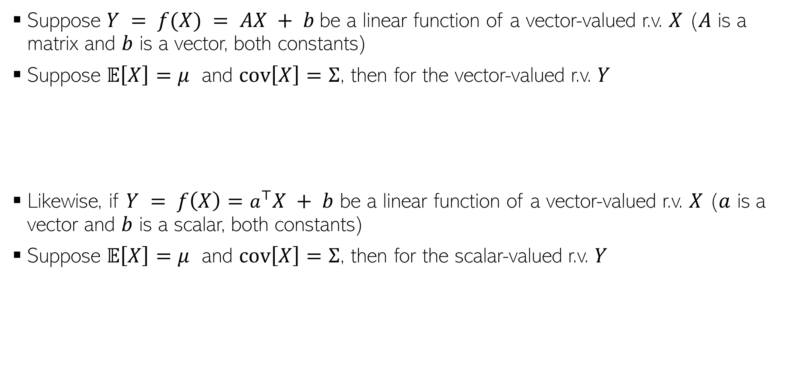
Transformation of Random Variables
Suppose $Y = f(X) = AX + b$be a linear function of a vector-valued r.v. $X$ ($A$ is a matrix and $b$ is a vector, both constants)
Suppose $𝔼\left[X\right]=μ$ and $cov\left[X\right]=Σ$, then for the vector-valued r.v. $Y$
Likewise, if $Y = f\left(X\right)=a^{⊤}X + b$ be a linear function of a vector-valued r.v. $X$ ($a$ is a vector and $b$ is a scalar, both constants)
Suppose $𝔼\left[X\right]=μ$ and $cov\left[X\right]=Σ$, then for the scalar-valued r.v. $Y$
$$𝔼\left[Y\right]=𝔼\left[AX+b\right]=Aμ+b$$
$$cov\left[Y\right]=cov\left[AX+b\right]=AΣA^{⊤}$$
$$𝔼\left[Y\right]=𝔼\left[a^{⊤}X + b\right]=a^{⊤}μ+b$$
$$var\left[Y\right]=var\left[a^{⊤}X + b\right]=a^{⊤}Σa$$

Slide 27
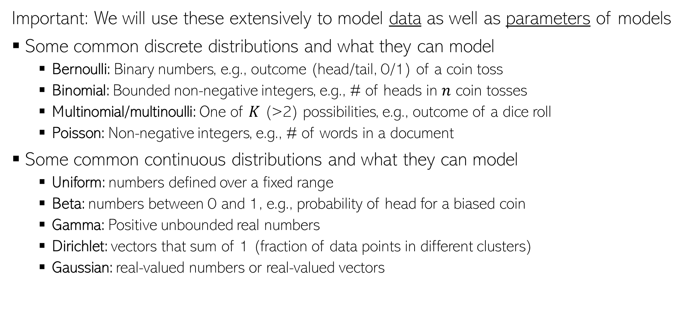
Common Probability Distributions
Important: We will use these extensively to model data as well as parameters of models
Some common discrete distributions and what they can model
Bernoulli: Binary numbers, e.g., outcome (head/tail, 0/1) of a coin toss
Binomial: Bounded non-negative integers, e.g., # of heads in $n$ coin tosses
Multinomial/multinoulli: One of $K$ (>2) possibilities, e.g., outcome of a dice roll
Poisson: Non-negative integers, e.g., # of words in a document
Some common continuous distributions and what they can model
Uniform: numbers defined over a fixed range
Beta: numbers between 0 and 1, e.g., probability of head for a biased coin
Gamma: Positive unbounded real numbers
Dirichlet: vectors that sum of 1 (fraction of data points in different clusters)
Gaussian: real-valued numbers or real-valued vectors

